Slide 1
Using the focused and diffuse modes
(Or, a little Dalí will do ya)
By Barbara Oakley, PhD

Slide 2
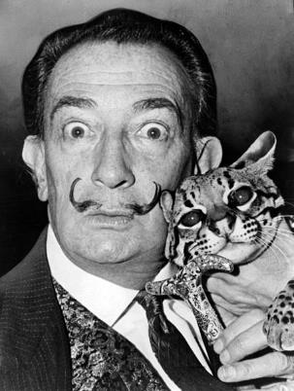
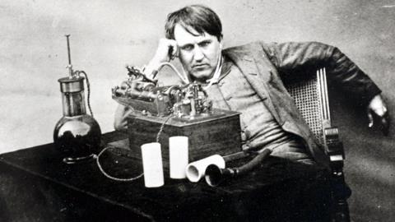
Thomas Edison
Salvador Dalí
Notes:
Brilliant inventor Thomas Edison used a clever trick to switch from focused to diffuse mode.
The persistance of memory—salvidor Dali
For those of you who might think “over-the-top” creative behavior started with Lady Gaga, well, it aint so.
Dalí was introduced to America by art dealer Julien Levy in 1934. The exhibition in New York of Dalí's works, including Persistence of Memory, created an immediate sensation. Social Register listees feted him at a specially organized "Dalí Ball". He showed up wearing a glass case on his chest, which contained a brassiere.^{[29]} In that year, Dalí and Gala also attended a masquerade party in New York, hosted for them by heiress Caresse Crosby. For their costumes, they dressed as the Lindbergh baby and his kidnapper. The resulting uproar in the press was so great that Dalí apologized. When he returned to Paris, the Surrealists confronted him about his apology for a surrealist act.^{[30]}

Slide 3
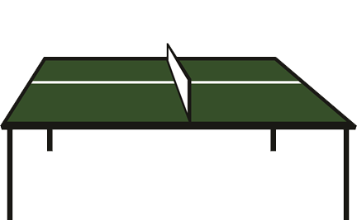
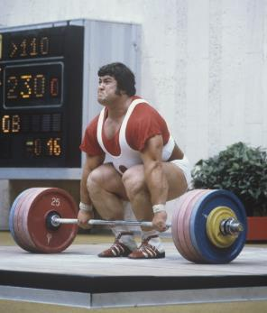
Focusing intently in ONE session to figure something out can be the worst approach possible
It takes time

Slide 4
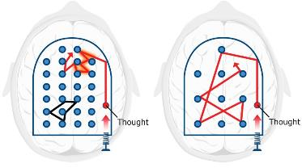
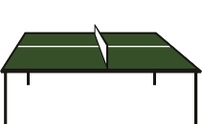
Summary
Metaphors provide powerful techniques for learning
Focused and diffuse modes
Learning something difficult takes time

Slide 5
Image Credits
Thomas Edison, courtesy U.S. Department of the Interior, National Park Service, Thomas Edison National Historical Park
Salvador Dalí with ocelot and cane, 1965; http://en.wikipedia.org/wiki/ File:Salvador_Dali_NYWTS.jpg From the Library of Congress. New York World- Telegram & Sun collection. http://hdl.loc.gov/loc.pnp/cph.3c14985; Author: Roger Higgins, World Telegram staff photographer; no copyright restriction known. Staff photographer reproduction rights transferred to Library of Congress through Instrument of Gift.
Weight lifter Sultan Rakhmanov, photo by Vitaliy Saveliev, http://commons.wikimedia.org/wiki/File:RIAN_archive_497570_Weight_lifter_Sultan_Rakhmanov.jpg
Pinball machine, image © 2014 Kevin Mendez
Focused and diffuse thinking, image © 2014 Kevin Mendez
Ping pong, image © 2014 Kevin Mendez
Relevant Readings
Dali, Salvador. Fifty Secrets of Magic Craftsmanship. Dover, 1948 (reprint 1992).
Root-Bernstein, Robert S., and Michelle M. Root-Bernstein. Sparks of Genius. NY: Houghton Mifflin, 1999.
Takeuchi, H., Y. Taki, H. Hashizume, Y. Sassa, T. Nagase, R. Nouchi, and R. Kawashima. "The Association between Resting Functional Connectivity and Creativity." Cerebral Cortex 22, no. 12 (Jan 10 2012): 2921-29.

